Slide 1

Key Themes for
Accelerating Performance Improvement
Paula Griswold, MS
Executive Director
MA Coalition for the Prevention of Medical Errors

Slide 2
ECRI Top Patient Safety Concerns for 2018
Diagnostic errors
Opioid safety across the continuum of care
Internal care coordination
Workarounds
Incorporating health IT into patient safety programs
Management of behavioral health needs in acute care settings
All-hazards emergency preparedness
Device cleaning, disinfection, and sterilization
Patient engagement and health literacy
Leadership engagement in patient safety

Slide 3
Which are organizational strategies?
Diagnostic errors
Opioid safety across the continuum of care
Internal care coordination
Workarounds
Incorporating health IT into patient safety programs
Management of behavioral health needs in acute care settings
All-hazards emergency preparedness
Device cleaning, disinfection, and sterilization
Patient engagement and health literacy
Leadership engagement in patient safety

Slide 4
ECRI Top Patient Safety Concerns for 2019
Diagnostic stewardship and test result management using EHRs
Antimicrobial stewardship in physician practices and aging services
Burnout and its effect on patient safety
Patient safety concerns involving mobile health
Reducing discomfort with behavioral health
Identifying changes in a patient's condition
Developing and maintaining skills
Early sepsis recognition across the care continuum
Infections from peripherally inserted IV lines
Standardizing safety efforts across large health systems

Slide 5
2019
Which are organizational strategies?
Diagnostic stewardship and test result management using EHRs
Antimicrobial stewardship in physician practices and aging services
Burnout and its effect on patient safety
Patient safety concerns involving mobile health
Reducing discomfort with behavioral health
Identifying changes in a patient's condition
Developing and maintaining skills
Early sepsis recognition across the care continuum
Infections from peripherally inserted IV lines
Standardizing safety efforts across large health systems

Slide 6

Organizational Strategies to
Accelerate Improvement
Integrate performance improvement -goals
  Patient safety/Reliability:
  providing effective care – do the right thing every time
  Quality /evidence-based care
  Patient-centered care
  Efficiency – reducing waste/improving value
  Worker Safety
  Reduce Clinician/staff burnout – reducing wasted time
  Joy and Meaning in work - engaging staff in change
  Across system - Care coordination & population health

Slide 7
Organizational Strategies to
Accelerate Improvement
Integrate performance improvement goals
“Quality” as a business strategy
Meeting customers’ needs without waste
Not just improvement projects --- “project-itis”

Slide 8
Organizational Strategies to
Accelerate Improvement: Approach
Integrate/align performance improvement resources (no siloes)
  Quality
  Safety/Risk management
  Efficiency/lean
  Patient experience/patient relations
Decentralize – own the improvement work within units and departments
Proactive improvement – not (just)reactive

Slide 9
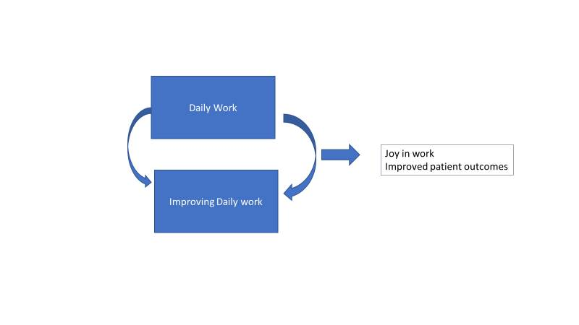
Improvement is Operations…
Notes:
As many of you already recognize ---
It’s not quality Improvement projects managed by the Quality Department –
Improvement is Operations, it’s how we do the story
Quality/Safety department can help with training, support and coaching

Slide 10
What drives experience & outcomes for patients?
Daily work – everyday operations:
1. System Design
- are work processes well designed?
2. Culture
- are defined work processes followed?
Patient
Experience
& Outcomes
Improving daily work:
1. Culture including commitment to safety
and continual learning
2. “See problems”
3. “Solve problems”

Slide 11

Strategies for Accelerating Improvement: Framework
Leadership
Culture
Learning System for Process Improvement
Patient and Family Engagement
Staff Engagement

Slide 12
Today
Continue to provide models:
Framework for organizational transformation to accelerate improvement
Agenda:
Organizational strategies
Improving diagnostic process
Engage you in giving feedback
  What would help you make these changes in your organization

Slide 13
Building a Massachusetts Partnership to Accelerate Improvement
Partner with other organizations in the state
Continue to learn from each other:
  Share strategies, critical success factors, curriculum
  With healthcare leaders and patients and families
Designing systems for staff engagement in improving work – toward all goals

